Slide 1
Major Global Environmental Problem: Pollution-M. Sarma
Environmental pollution is a broad concept which includes pollution of various biological and physical components of the planet as a result of human activities. Going by this definition, it can be categorized into various types. When we talk about the different types, we usually refer to the pollution of air, water, and land. What we fail to understand, is the fact that this concept also includes noise pollution, thermal pollution, and radiation pollution. We cannot afford to turn a blind eye to this environmental issue any more, as the pollutants are being dumped in the environment at a rate which far exceeds the rate at which it can accommodate them.

Slide 3
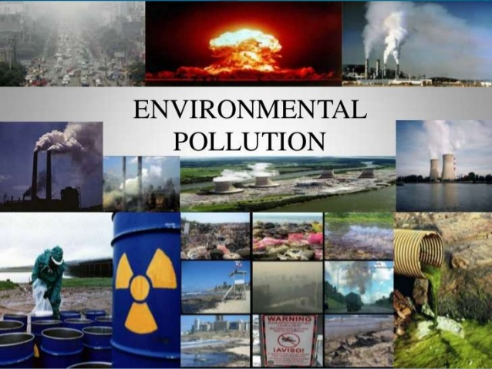

Slide 4
Environmental pollution means lowering of environmental quality at local scale caused exclusively by human activities whereas Environmental degradation means lowering of environmental quality at local, regional, and global levels by both natural process and human activities.
Acc. to NERC in 1976 ‘Environmental pollution is the release of substances and energy as waste products of human activities which result in changes, usually harmful, within the natural environment.’

Slide 5
Source of Pollution:
Source of Pollution is divided into two categories viz. a) Natural and
b) Anthropogenic .Natural sources includes volcanic ashes, dust layer in the atmosphere
Flood water, cosmic particular etc. Anthropogenic sources are industrial source, urban source, agricultural source, population etc.

Slide 6
Pollution is generally divided into two broad categories:
i) Physical Pollution- physical pollution is caused due to lowering of the quality of physical or abiotic components of the environment by human activities and is further into three subtypes.
Land Pollution: Examples: a) accelerated rate of soil erosion through rill gully erosion b) desertification c) soil pollution d) salinization etc.
Water Pollution: Example a) pollution of sea water b) pollution of groundwater c) pollution of streams d) pollution of lakes

Slide 9
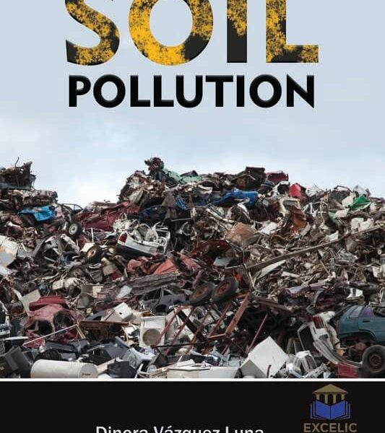

Slide 10
Noise Pollution

Slide 11
c) Air Pollution: (a) depletion of ozone layer, (b) increase in the concentration of greenhouse gases in the atmosphere, (c) decrease in the quality of air,etc.
(ii) Social Pollution: Pollution caused in different aspects of the society due to cumulative effects of extreme events/ hazards and pollution. Social pollution may be further divided into several sub-types.
(A) Population Explosion
(B) Sociological Pollution
Examples: (a) educational and social backwardness, (b) crimes, (c) perpetual quarrels (d)wars, (e) communal riots etc.
(C) Economic Pollution: Example: Poverty

Slide 13
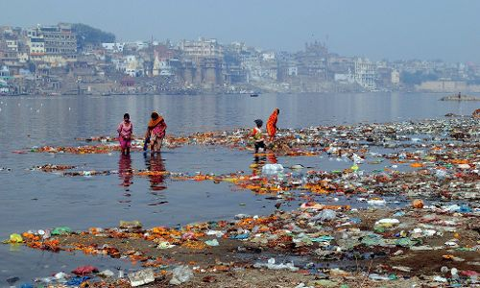
Pollution of Ganga river

Slide 16
Environmental Hazards may be defined as those extreme events either natural or man-induced, which exceed the tolerable magnitude within or beyond certain time limit. Example: Flood, Drought etc.
Environmental Disaster are the results or responses of environmental hazards.For example,a very strong cyclone becomes only extreme event when it occurs and dies in the midst of an ocean but it becomes disaster when it strikes the inhabited coastal and cause for loss of human lives and property.

Slide 17
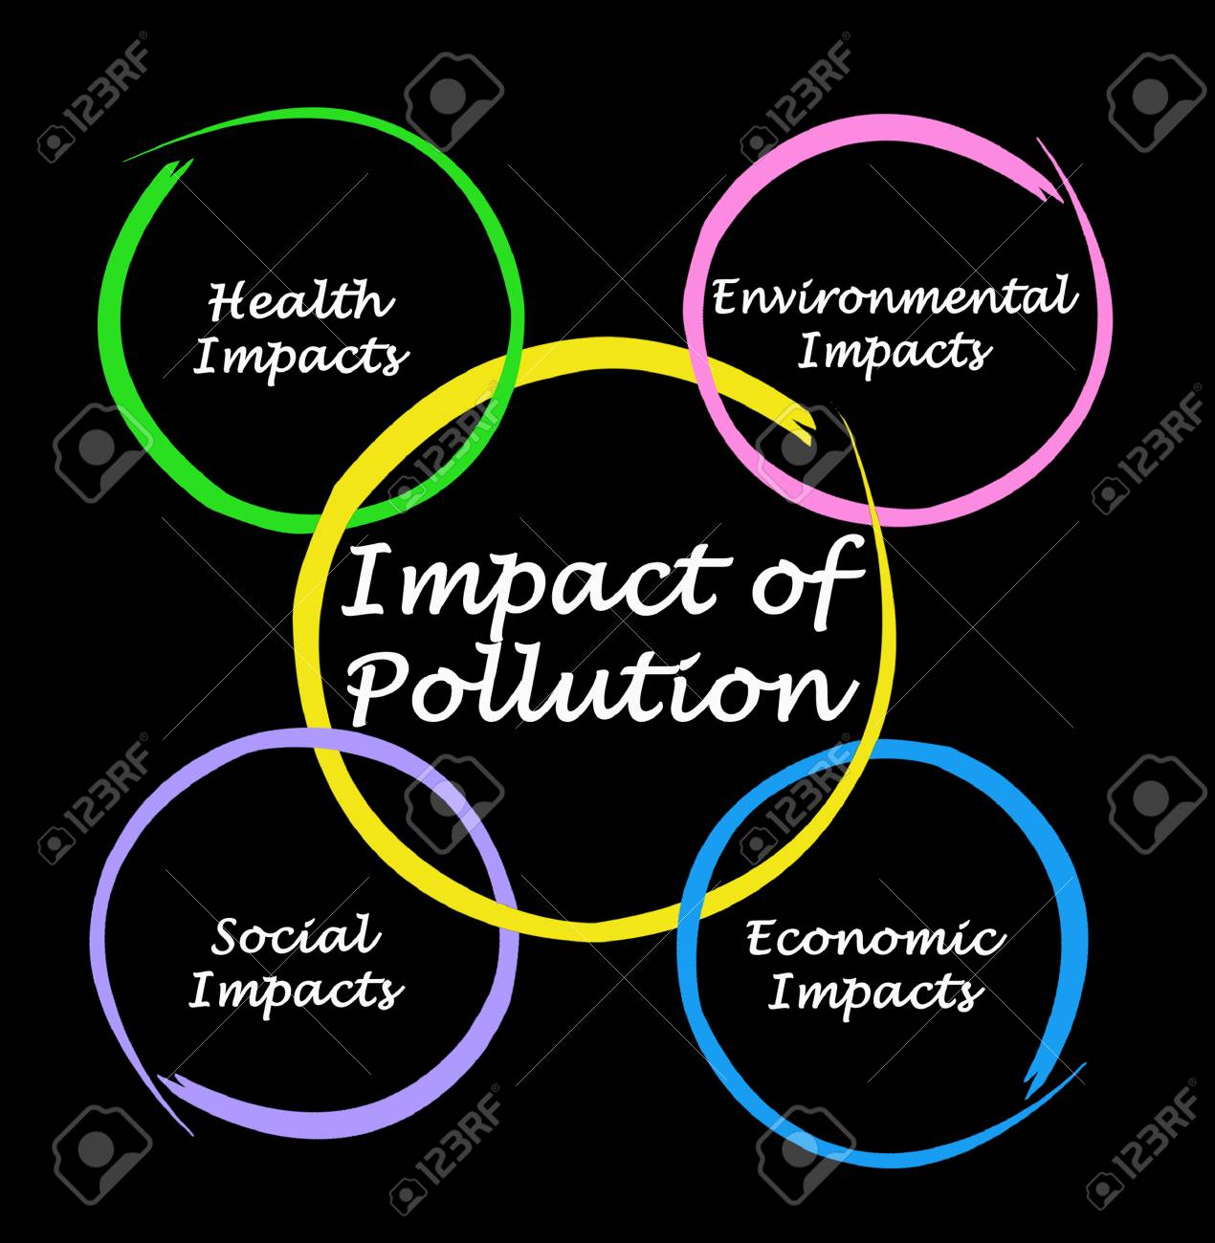

Slide 18
What Is Deforestation?
Deforestation refers to the decrease in forest areas across the world that are lost for other uses such as agricultural croplands, urbanization, or mining activities. Greatly accelerated by human activities since 1960, deforestation has been negatively affecting natural ecosystems, biodiversity, and the climate. The UN’s Food and Agriculture Organization estimates the annual rate of deforestation to be around 1.3 million km² per decade.

Slide 19
The Causes of Deforestation: Why Is Deforestation Happening?
Multiple factors, either of human or natural origin, cause deforestation. Natural factors include natural forest fires or parasite-caused diseases which can result in deforestation. Nevertheless, human activities are among the main causes of global deforestation. According to the Food and Agriculture Organization (FAO), the expansion of agriculture caused nearly 80% of global deforestation, with the construction of infrastructures such as roads or dams, together with mining activities and urbanization, making up the remaining causes of deforestation.

Slide 21
Agriculture is the Number 1 Cause of Deforestation (~80%)
Why is deforestation happening? According to the FAO, agriculture causes around 80% of deforestation. And how does agriculture cause so much deforestation? According to the same report, 33% of agriculture-caused deforestation is a consequence of subsistence agriculture – such as local peasant agriculture in developing countries.

Slide 23
Commercial or industrial agriculture (field crops and livestock) cause around 40% of forest loss – in the search for space to grow food, fibers or biofuel (such as soybeans, palm oil, beef, rice, maize, cotton and sugar cane). It is also particularly interesting to note livestock is believed to be responsible for about 14% of global deforestation. The main reasons why have to do with the large areas require both to raise livestock but also to grow its (soy-based) food.

Slide 24
Deforestation Caused By New Constructions (~15%)
The construction of human infrastructures has also been driving deforestation. More specifically, 10% of deforestation can be attributed to new infrastructures that serve the current human lifestyle in four main ways: transportation, transformation and energy generation.
On one hand, roads, rails, ports or airports have been built to move all sorts of goods – from cereals and fruits to spices, minerals or fossil fuels – either directly to trade centers or to transformation sites. So while at first there were only fruit trees, roads soon arrived to allow transporting fruit to other regions. And while some goods were and are collected manually, others such as coal, oil, natural gas, biomass, but also meat, dairy or spirits, required the construction of large extraction, transportation and/or transformation

Slide 31
How Urbanization Is Causing Deforestation(~5%)
The populational shift that is leading people to move from rural areas to urban areas is also contributing to deforestation (5%, according to FAO). This urban growth – in which 68% of the world’s population is expected to live in cities by 2050 – is leading to an exponential growth of housing and consumption sites. And as cities become larger so they can host more people, they challenge the natural boundaries surrounding them, often leading to deforestation. This is one of the reasons why deforestation is happenin

Slide 32
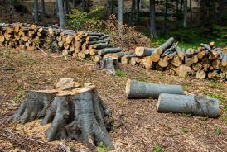

Slide 33
The Effects of Deforestation on Biodiversity
The most known consequence of deforestation is its threat to biodiversity. In fact, forests represent some of the most veritable hubs of biodiversity. From mammals to birds, insects, amphibians or plants, the forest is home to many rare and fragile species. 80% of the Earth’s land animals and plants live in forests.
By destroying the forests, human activities are putting entire ecosystems in danger, creating natural imbalances, and putting Life at threat. The natural world is complex, interconnected, and made of thousands of inter-dependencies and among other functions, trees provide shade and colder temperatures for animals and smaller trees or vegetation which may not survive with the heat of direct sunlight. Besides, trees also feeding animals with their fruits while providing them with food and shelter they need to survive.

Slide 34
The Effects of Deforestation on Local People and Their Livelihoods
Healthy forests support the livelihoods of 1.6 billion people globally, one billion of whom are among the world’s poorest. This means there are many people depending on forests for survival and using them to hunt and gather raw products for their small-scale agriculture processes. But in developing countries such as Borneo, Indonesia, Vietnam, Brazil, or Mexico, land tenure systems are weak. This allows big businesses to get these lands and use them for other ends, disrupting local people’s lives.

Slide 35
Many a time local people then have to make one of two choices. They can decide to abandon “their” land and migrate somewhere else, avoiding conflict and embracing the challenge of a new different life. Or they can stay and work for the companies exploring it in remote plantations – often getting unfair wages and working under inhumane conditions. In some countries like Mexico, plantations’ owners are often forced to share their profits with local cartels to keep their families alive and to avoid having their crops burned.

Slide 36
Deforestation for Food May Lead to Food Insecurity in the Future
Today, 52% of all the land used for food production is moderately or severely impacted by soil erosion. In the long term, the lack of healthy, nutritious soil can lead to low yields and food insecurity.

Slide 37
Soil Erosion is One of the Consequences of Deforestation
Deforestation weakens and degrades the soil. Forested soils are usually not only richer on organic matter, but also more resistant to erosion, bad weather, and extreme weather events. This happens mainly because roots help fix trees in the ground and the sun-blocking tree cover helps the soil to slowly dry out. As a result, deforestation will probably mean the soil will become increasingly fragile, leaving the area more vulnerable to natural disasters such as landslides and floods.

Slide 38
Deforestation Affects and Contributes to Climate Change
Deforestation also has a very strong contribution to climate change. Why? Let’s remember trees absorb and store CO2 throughout their lives. If we speak about tropical forests, they hold more than 210 gigatons of carbon, according to WWF. And what’s worrying is that the destruction of these trees has two big negative side-effects.
Firstly, taking down trees means they’ll release back into the atmosphere the CO2 they were keeping. Secondly, fewer trees available means reducing the planet’s overall ability to capture and store CO2. Both these effects negatively contribute to the greenhouse effect and to climate change. As a matter of fact, while food and agriculture account for 24% of greenhouse gas emissions, deforestation is estimated to be responsible for 10-15% of all anthropogenic CO2 emissions.

Slide 39
DESERTIFICATION
Desertification is a significant global ecological problem. It is a land degradation problem of major importance, in the arid region of the world. The word ‘Desertification’ is basically another word for degradation of the land in dry areas of the world, primarily caused by human activities.

Slide 40
. What is desertification?
Present-day Drylands
Desertification refers to the persistent degradation of dryland ecosystems by climatic variations and human activities. It occurs on all continents (except Antarctica) and affects the livelihoods of millions of people, including a large proportion of the poor in drylands.
The U.N. Convention to Combat Desertification (UNCCD) defines it as “land degradation in arid, semiarid and dry subhumid areas resulting from various factors, including climatic variations and human activities.” Land degradation is in turn defined as the reduction or loss of the biological or economic productivity of drylands.

Slide 41
Acc. to United Nation(1994) Desertification is the ‘Degradation of soil, landscape and bio-productive terrestrial system in arid, semi-arid and sub humid areas, resulting from several factors, including climate change and human activities.
Desertification refers to persistent degradation of dry land ecosystem by climatic variations and human activities .It occurs on all continents (except Antarctica) and affects the livelihoods of millions people, including a large proportion of the poor in dry lands.

Slide 42
GLOBAL WARMING
Global warming refers to the increase in the temperatures of Earth’s oceans and atmosphere. Most scientists believe that the temperature increases are due to the greenhouse effect. Machines that we make and other human activities emit pollution which subsequently exacerbates the greenhouse effect.
In the past 140 years, the average temperature of Earth’s lower atmosphere has risen by 0.6°C. However, by the year 2070, scientists predict that the temperature will have risen by 1.5°C to 2°C. ‘°C‘ stands for degrees Celsius or degrees Centigrade.
If you look at historical temperature charts over the past thousand years, they all look like hockey sticks. There is a long period of relative stability, then in 1900, temperatures start rising.
Scientists from the Department of Energy’s Pacific Northwest National Laboratory warned that global warming will accelerate. After carrying out a study, they said that we will all have to learn to adapt.

Slide 43
Global warming could dramatically change climate zone patterns. This means that rainfall, snow, winds, and other weather phenomena could significantly change different parts of the world.
For example, rising temperatures could melt the polar ice caps and subsequently push up sea levels across the planet. Low-lying towns and cities might experience serious flooding in decades to come. In fact, there may be permanent flooding in some major cities and other low-lying areas where humans live,
crop failures may devastate huge areas in the Americas and Asia due to hotter and drier conditions.

Slide 44
Natural Causes of Global Warming
Forest Fires: Deforestation by nature is another leading cause of Global Warming. Forest fires emit carbon-filled smoke into the atmosphere, and new forests’ growth is slow and not stable enough to produce the much needed oxygen into the newly, suffocating carbon air.
Permafrost: When frozen soil, constituting about 25% of the Northern Hemisphere, increases, it keep the carbon and methane gases. This permafrost actually leaks carbon into the earth’s atmosphere and scientists also cannot stop permafrost from emitting these gases which melting icecaps at incredibly fast rate. This lead to climate change.

Slide 45
Sunspots: According to Environment Protection Agency(EPA) Sunspots are increasing global temperature.
Water Vapour: According to NASA, two thirds of the gases struck in the thick blanket is in the form of water vapour.
Volcanic Eruption: Volcanic eruptions are also one of the major reasons global warming. Due to volcanic eruption there is emission of Carbon dioxide (Co2) nitrogen, oxide(No) sulpher,smoke and dust particles.

Slide 46
Manmade Causes of Global Warming
Aerosal in the Temperature:
Depletion of Ozone Layer:
Burning of Fossils:
Pollution:
Landfills:
Mining:
Fertilizer Use:
Industrial Advancement:
Air pollution:
Meat consumption:
Population Growth:

